Slide 1
CS441 Lecture: Mobile Applications and 5G technology – for Digital Transformation
Ravi Mittal
ravi.mittal@iitgoa.ac.in
Indian Institute of Technology, Goa

Slide 2
Contents
Mobile phone – Its role in personal and professional life
Mobile Applications
Mobile Phones and Digital Transformation
5G Mobile Technology and Digital Transformation

Slide 3
Mobile Phones – Very Important tool for our personal and professional lives

Slide 4
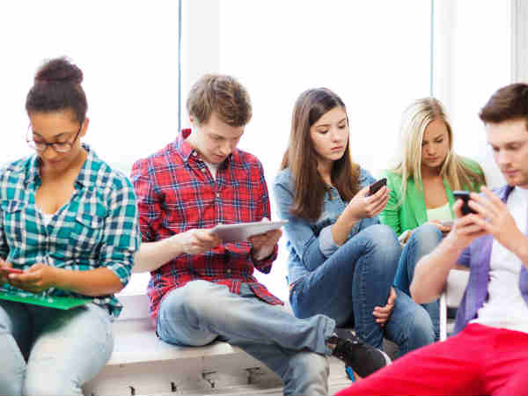
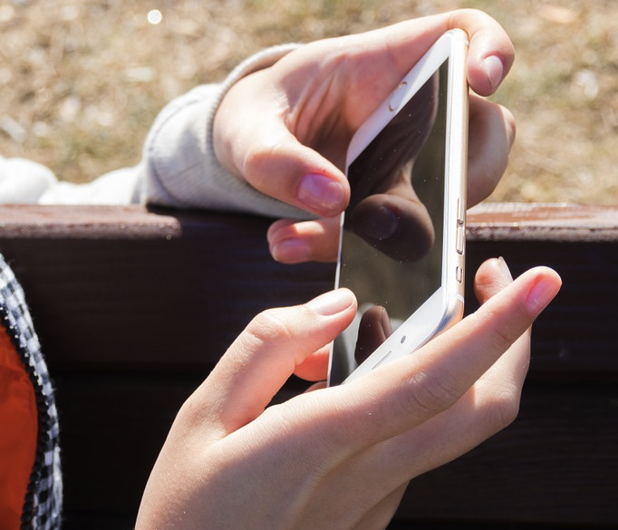

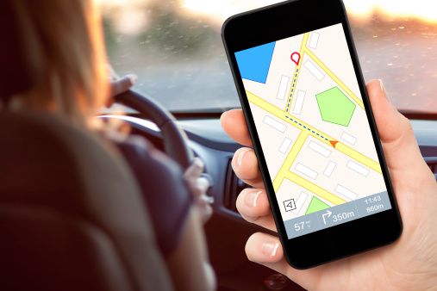

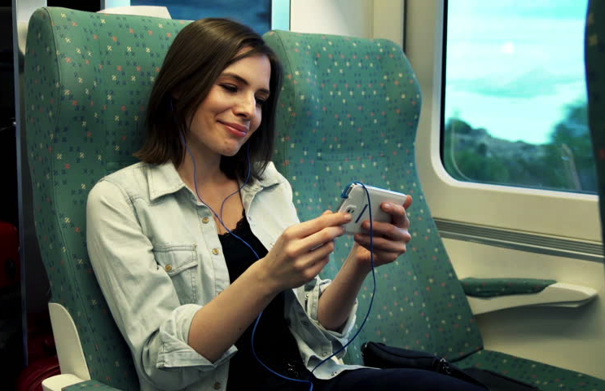
Ubiquitous Mobile Network Services
In-building
Outdoor
Walking
Driving
Subway
High-speed train
Notes:
Today, mobile internet anywhere, anytime.
(2) Today, Almost everyone can use mobile Internet anytime, anywhere.
%mobile Internet has become an important part of our everyday life.

Slide 5
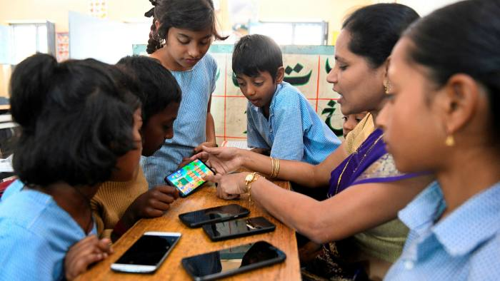


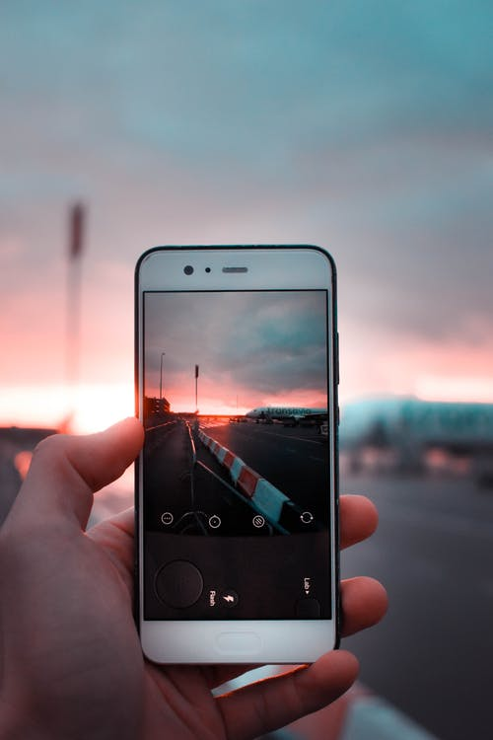
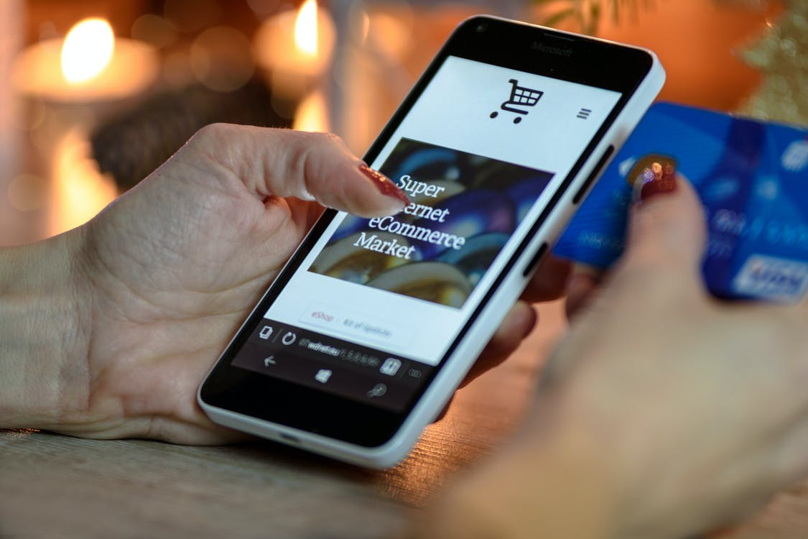

We are using it for everything..
Education
Entertainment
Business
Capturing precious
moments
Shopping
Video calls
Notes:
Today, mobile internet anywhere, anytime.
(2) Today, Almost everyone can use mobile Internet anytime, anywhere.
%mobile Internet has become an important part of our everyday life.

Slide 6
We are using it for everything..
Navigation
Medical
Messaging
Chatting
Emailing
Conference Calls
Banking
Music
Family
On-demand services
Stock Market
Selling
All types of shopping
Uber / Ola
News
Books/Magazines / Papers
Watching TV
Video Games
YouTube

Slide 7
Mobile Phone
Mobile phone → Computer that allows phone calls, shoot video, make transactions, make video calls, play music, read newspapers, exchange emails and instant messages, Internet device
It’s really big computer – bigger than Supercomputer of 80’s
Over 15 million lines of code
Millions of applications
It is a powerful computer that does a lot of things
It provides an integrated computing and communication platform with location awareness
→ A mobile can be used for million of applications →important tool for Digital Transformation

Slide 8
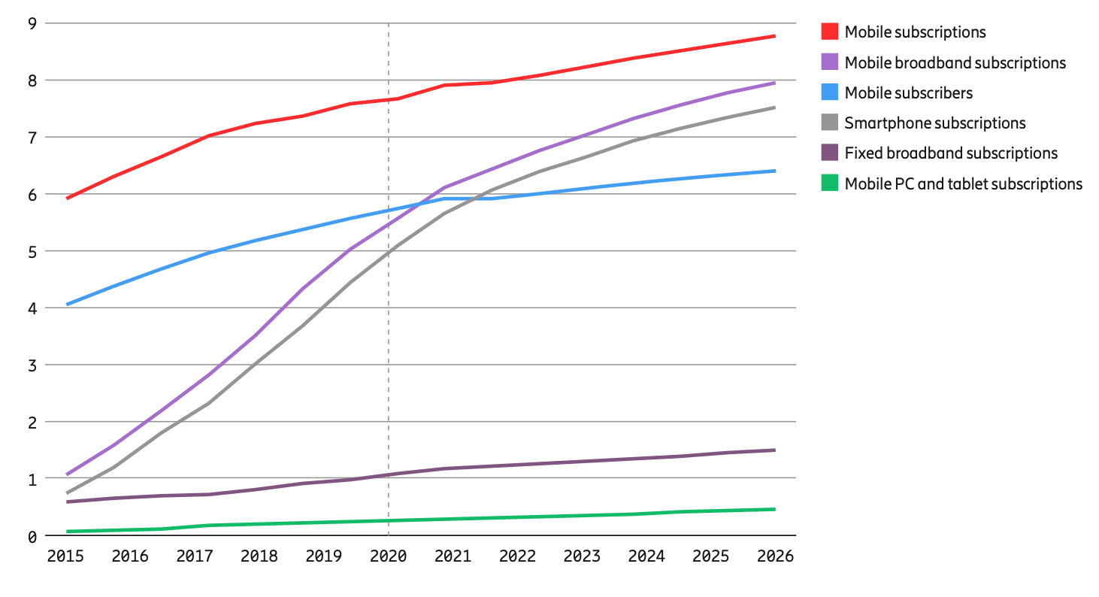
Mobile Subscriptions and subscribers (billion)
In beginning 2021: 7.9 billion mobile subscriptions and 6.1 billion smartphone subscriptions
Ref: Ericsson Mobility Report, Nov 2020, Mobile Subscription Outlook

Slide 9
Mobile Phone Statistics
Note that global human population in 2021: 7.8 Billion
Number of mobile phone subscriptions in 2121: 7.9 Billion
Number of Smart phone subscriptions in 2121: 6.1 Billion
Number of Smart phone subscription in 2626: 7.5 Billion
Businesses can reach 81% world population with mobile
Ref: Ericsson Mobility Report, Nov 2020, Mobile Subscription Outlook

Slide 10
Mobile Phone Statistics
70% of web traffic happens on a mobile device
85% of all pages in the mobile search results are labeled as mobile-friendly
Mobile data traffic around the world is projected to increase by 700% between 2016 and 2021
Apps account for 89% of mobile media time, with the other 11% spent on websites
More than 40% of online transactions are happening on mobile, as of 2017

Slide 11
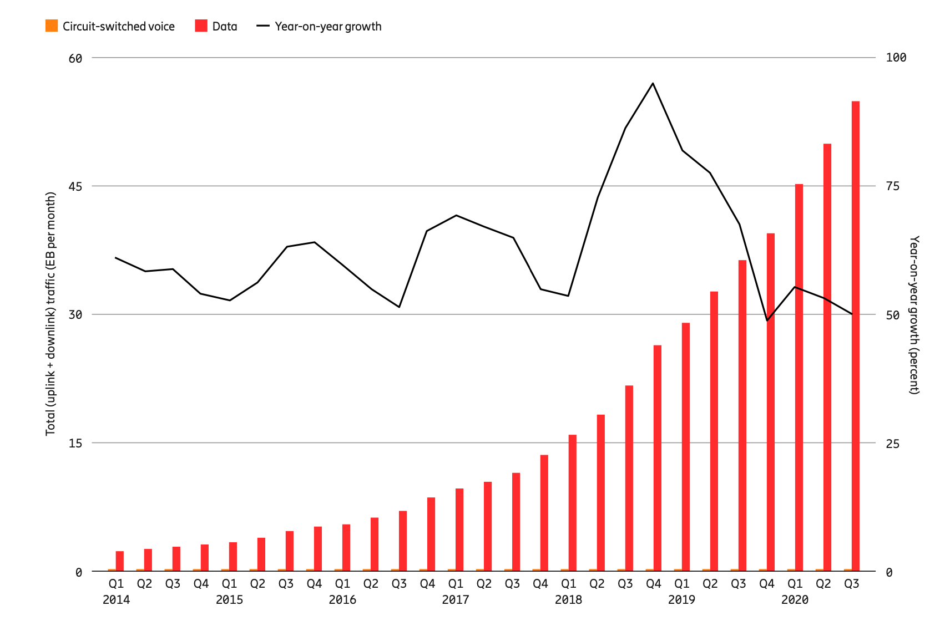
Global mobile network data traffic and year-on-year growth (EB per month)

Slide 12
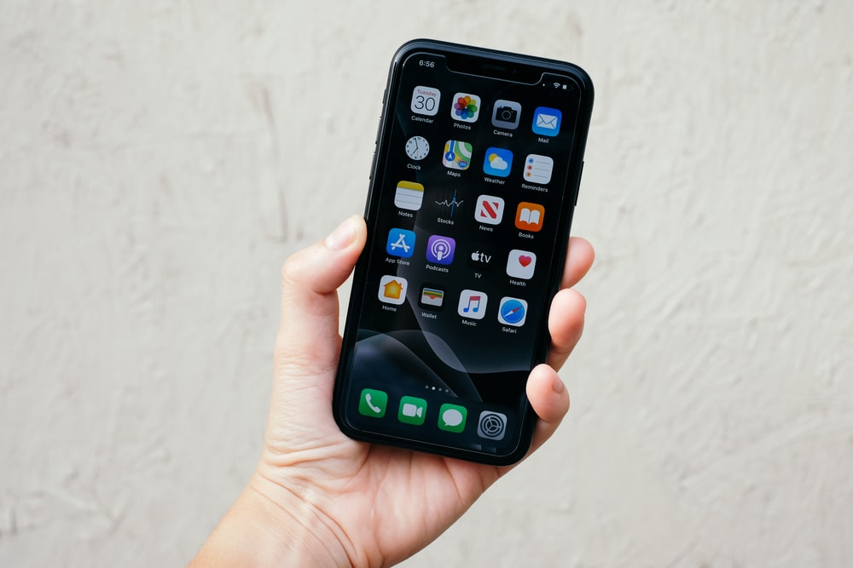
Mobile Apps
Applications have contributed significantly to mobile phone’s popularity
One can do almost everything one does it on Computer
80-100 applications on each mobile

Slide 13
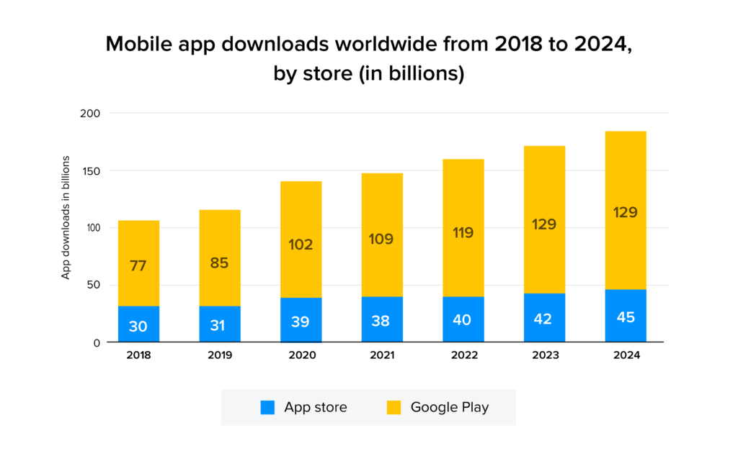
Mobile App Downloads

Slide 14
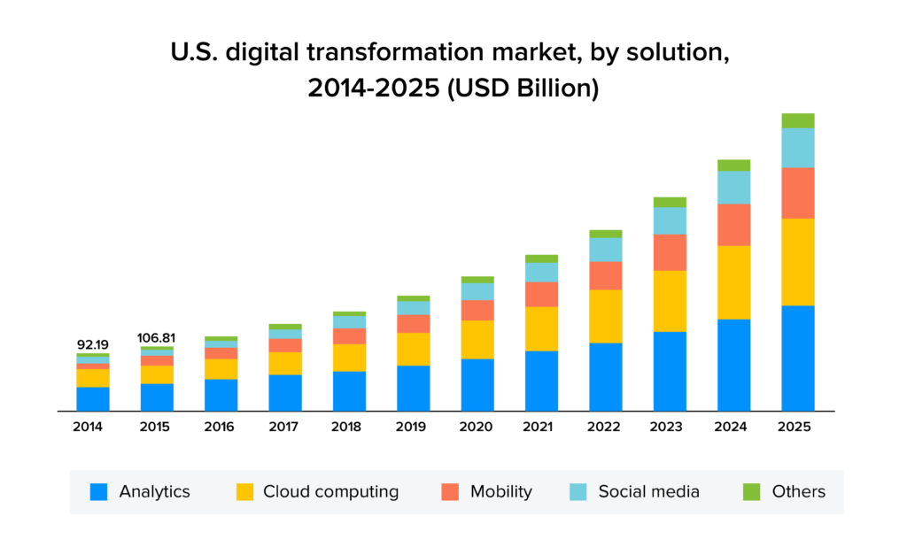

Slide 15
Mobile Applications

Slide 16
Supports Millions of Applications
Anyone individual or corporates can develop applications that can be used in a unique way by any number of users at any place
A mobile platform has
Computing power
Internet Connectivity over WiFi / Cellular
Sensors
Location awareness
Camera, I/O
Storage
Graphics
Leads to Digital Transformation

Slide 17
What are the total number of Mobile Applications in the world today?
0.1 Million (1 lakh)
1 Million
4 Million
9 Million
100 Million

Slide 18
What are the total number of Mobile Applications in the world today?
0.1 Million (1 lakh)
1 Million
4 Million
9 Million
100 Million
Mobile Applications are there for almost every requirement

Slide 19
What has contributed to Mobile App growth?
Convenience – Makes life easier
24*7 business, shopping
Increased Productivity
Communication and Engagement
People are spending time on Mobile (Addiction)
An average user checks his/her mobile phone in every eighteen minutes
Entertainment and Fun
Mobile TV
Live streaming
Chatting
Social Media
Technology behind its popularity: The Internet, www, Cloud

Slide 20
Mobile Phones and Digital Transformation

Slide 21
Mobile App as a driver for Digital Transformation
57% of the digital media use comes in through apps
An average smartphone user has over 80 apps out of which they use 40 apps every month
21% of millennials visit a mobile application 50+ times everyday

Slide 22
Mobile as a catalyst in Digital Transformation
Provides freedom to interact with the organization, as
A Customer
An Employee
Mobile App makes it easy for your customers to
Learn about your organization, Services offered and products
Interact with you
Place orders and make payments
Receive communications with about new offerings (marketing)
Mobile and Mobile Apps enhances employee’s productivity
Any place, any time – transactions and communication in real time
Mobile increases the speed and volume of interactions between a company and its customers
Easy access to customer data
Valuable insight into customer’s choices and preferences

Slide 23
Mobile as a catalyst in Digital Transformation
Increase in the number of customers → Business Growth
Location sensitive marketing
Mobile location feature provides customer’s location
Improved operation
Better customer experience
Customer Relationship building
Brand Building
Mobile Advertisements
Over social media sites, Messaging Applications, Push Notifications

Slide 24
5G Mobile Technology and Digital Transformation

Slide 25
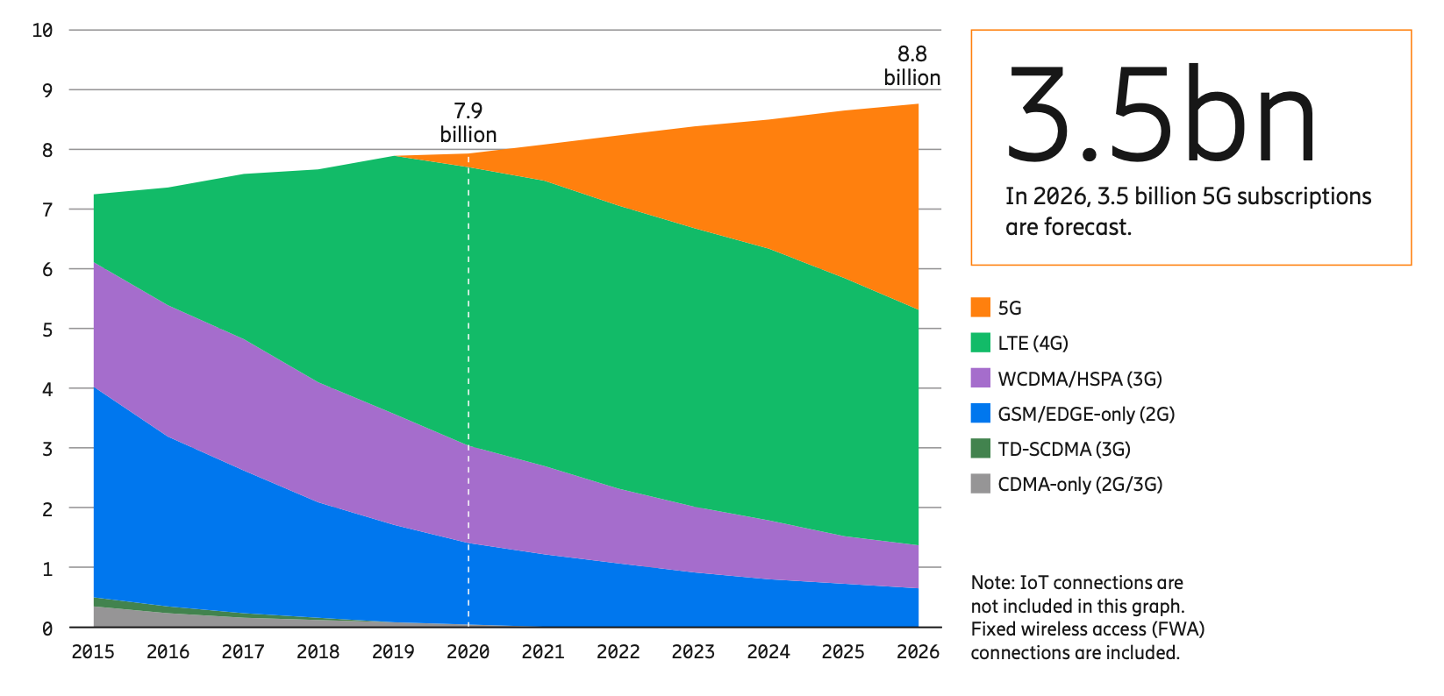
Mobile subscriptions by technology (billion)
Ref: Ericsson Mobility Report, Nov 2020, Mobile Subscription Outlook

Slide 26
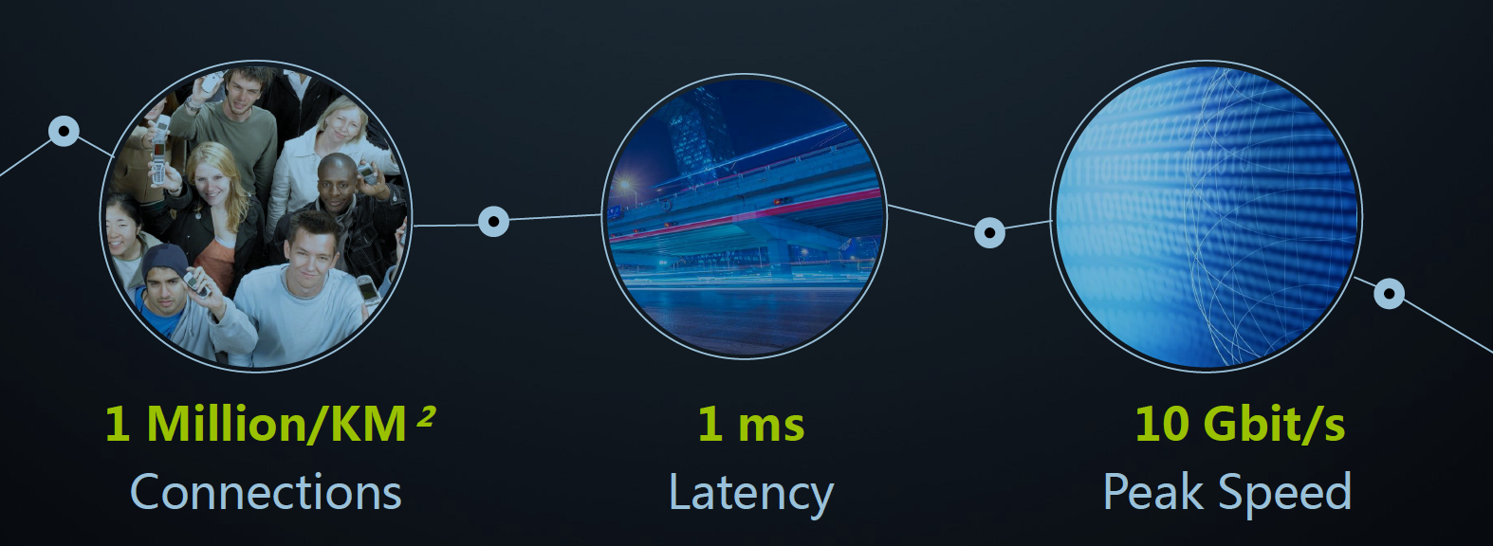
5G – Three key features
Note that Voice over IP calls have approximately 150 ms latency

Slide 27
On to 5G
Speed: Upto 10 Gbps data rate
Millimeter wave frequencies: much higher data rates, but over shorter distances
Pico-cells: cells diameters: 10-100 m
massive, dense deployment of new base stations required
Latency: 1-Millisecond latency
Network Capacity: 100x increase in traffic capacity over 4G
1 million nodes per Km²
Ultra High Reliability
1 out of 100 Million packet loss
Mobility: Should work on 500 Km/hour Railway
Low energy consumption → High battery life
Strong Security
Massive Connectivity for IoT

Slide 28
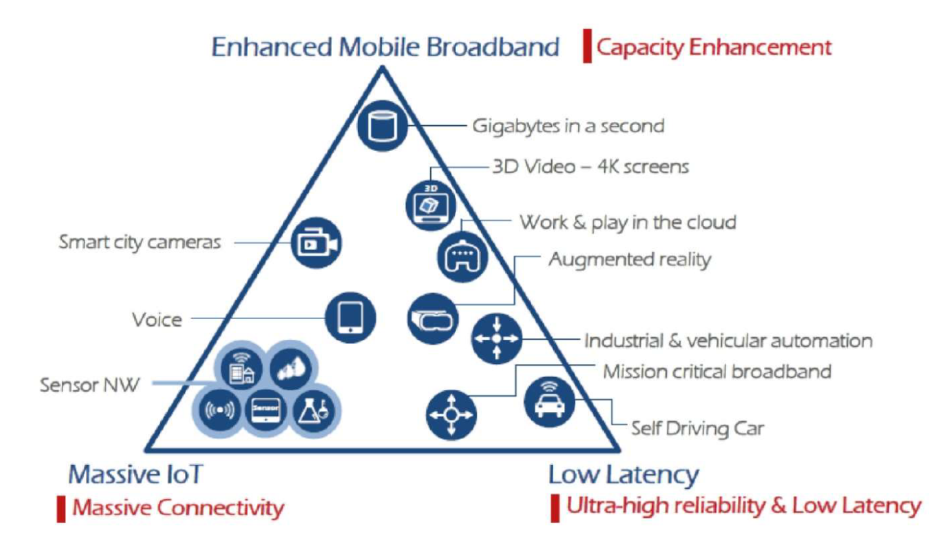
https://www.itu.int/dms_pubrec/itu-r/rec/m/R-REC-M.2083-0-201509-I!!PDF-E.pdf

Slide 29
5G use cases
Massive Machine-to-Machine (M2M) communication
Support for billions of IoT devices
Ipv6 addressing will help this cause (ie. With 128 bit IP addresses)
Ultra Reliable low latency communication
Support for mission critical real-time communication
Safety systems
Autonomous Driving
Industrial Robotics
Etc
Enhanced Mobile Network
High Data Speed
Peak data rates up to 20 Gbps

Slide 30
Use Cases based on: Ultra High Reliability
Support for mission critical real-time communication
Safety systems
Autonomous Driving
Industrial Robotics
Health care
Remote health care solutions, Remote robotic surgery etc

Slide 31
5G in Real-time systems
Real-time systems
Bounded delays, low delays
5G communication allows low and bounded delays
5G can be used in any real-time system
Eg. Remote train, flight, drone control
Automated factory remote control

Slide 32
5G in Healthcare
Mobile remote care solutions
Extended reachability to any patent in remote places
Video conferencing
Remote consultation with doctors
Elderly patient’s health monitoring in real-time

Slide 33
5G in Manufacturing
Smart manufacturing
Modern factories are becoming automated with
Robots and Advanced Machines
Array of sensors connected to high powered Analytics Engine
Production Optimization
Capturing real-time data on machines, inventory and production
Optimize flow, sequencing, and productivity
Modular Factory
Tools and Robots can be repurposed quickly – mass customization and manufacturing on demand
Use of 5G’s potential density, speed, low latency
5G eliminates need for wired connectivity
Higher Flexibility
Higher connectivity – Just connect anything

Slide 34
5G in Manufacturing
Supply Chain Integration
Use of 5G – results into fast, automatic replenishment of parts and supplies → decreases delays and scales efficiency
Preventive Maintenance
Denser arrays of sensors allow companies to monitor the status of equipment more closely
Safety
Safer manufacturing environment with use of a wide array of sensors, enablement of instantaneous response
Fewer people are needed on shop floor

Slide 35
5G in Self driving Cars
Self driving cars will require bandwidth between 3 to 40 Gbits/second
5G will provide connectivity within and outside autonomous cars
Low Latency – time it takes to send information from one point to another end point
It is very important parameter in self-driving cars as most of the decisions should be taken in very short time – so communication time has to be very less – 1millisecond to 5 millisecond
Compare this to human reaction speed of 200 millisecond
Reliable Communication
Must for Self driving and regular cars
Data based car maintenance and diagnostics

Slide 36
5G in Media and Entertainment
Enhanced Mobile Media
Home broadband and TV
Immersive Media – Virtual Reality, Augmented Reality, Gaming
In-car entertainment

Slide 37
5G Use cases - Others
Agriculture
Energy Sector
Environment
IoT
3D application
Education
Healthcare
Space
What else ??

Slide 38
Lecture Summary
Mobile Phones – brings Internet to over 50% of world’s population
With Mobile Internet, a user can use millions of applications
5G mobile technology has important characteristics of
Low delay (latency)
High Reliability (almost no packet loss)
High Bandwidth
Ability to work in high population density areas
5G mobile technology can be used in a very large number of ways to develop, manage, support – applications and operations that leads to Digital Transformation

